Slide 1
Relational Algebra (Part-5)
20.4

Slide 2
Contents
Union

Slide 3
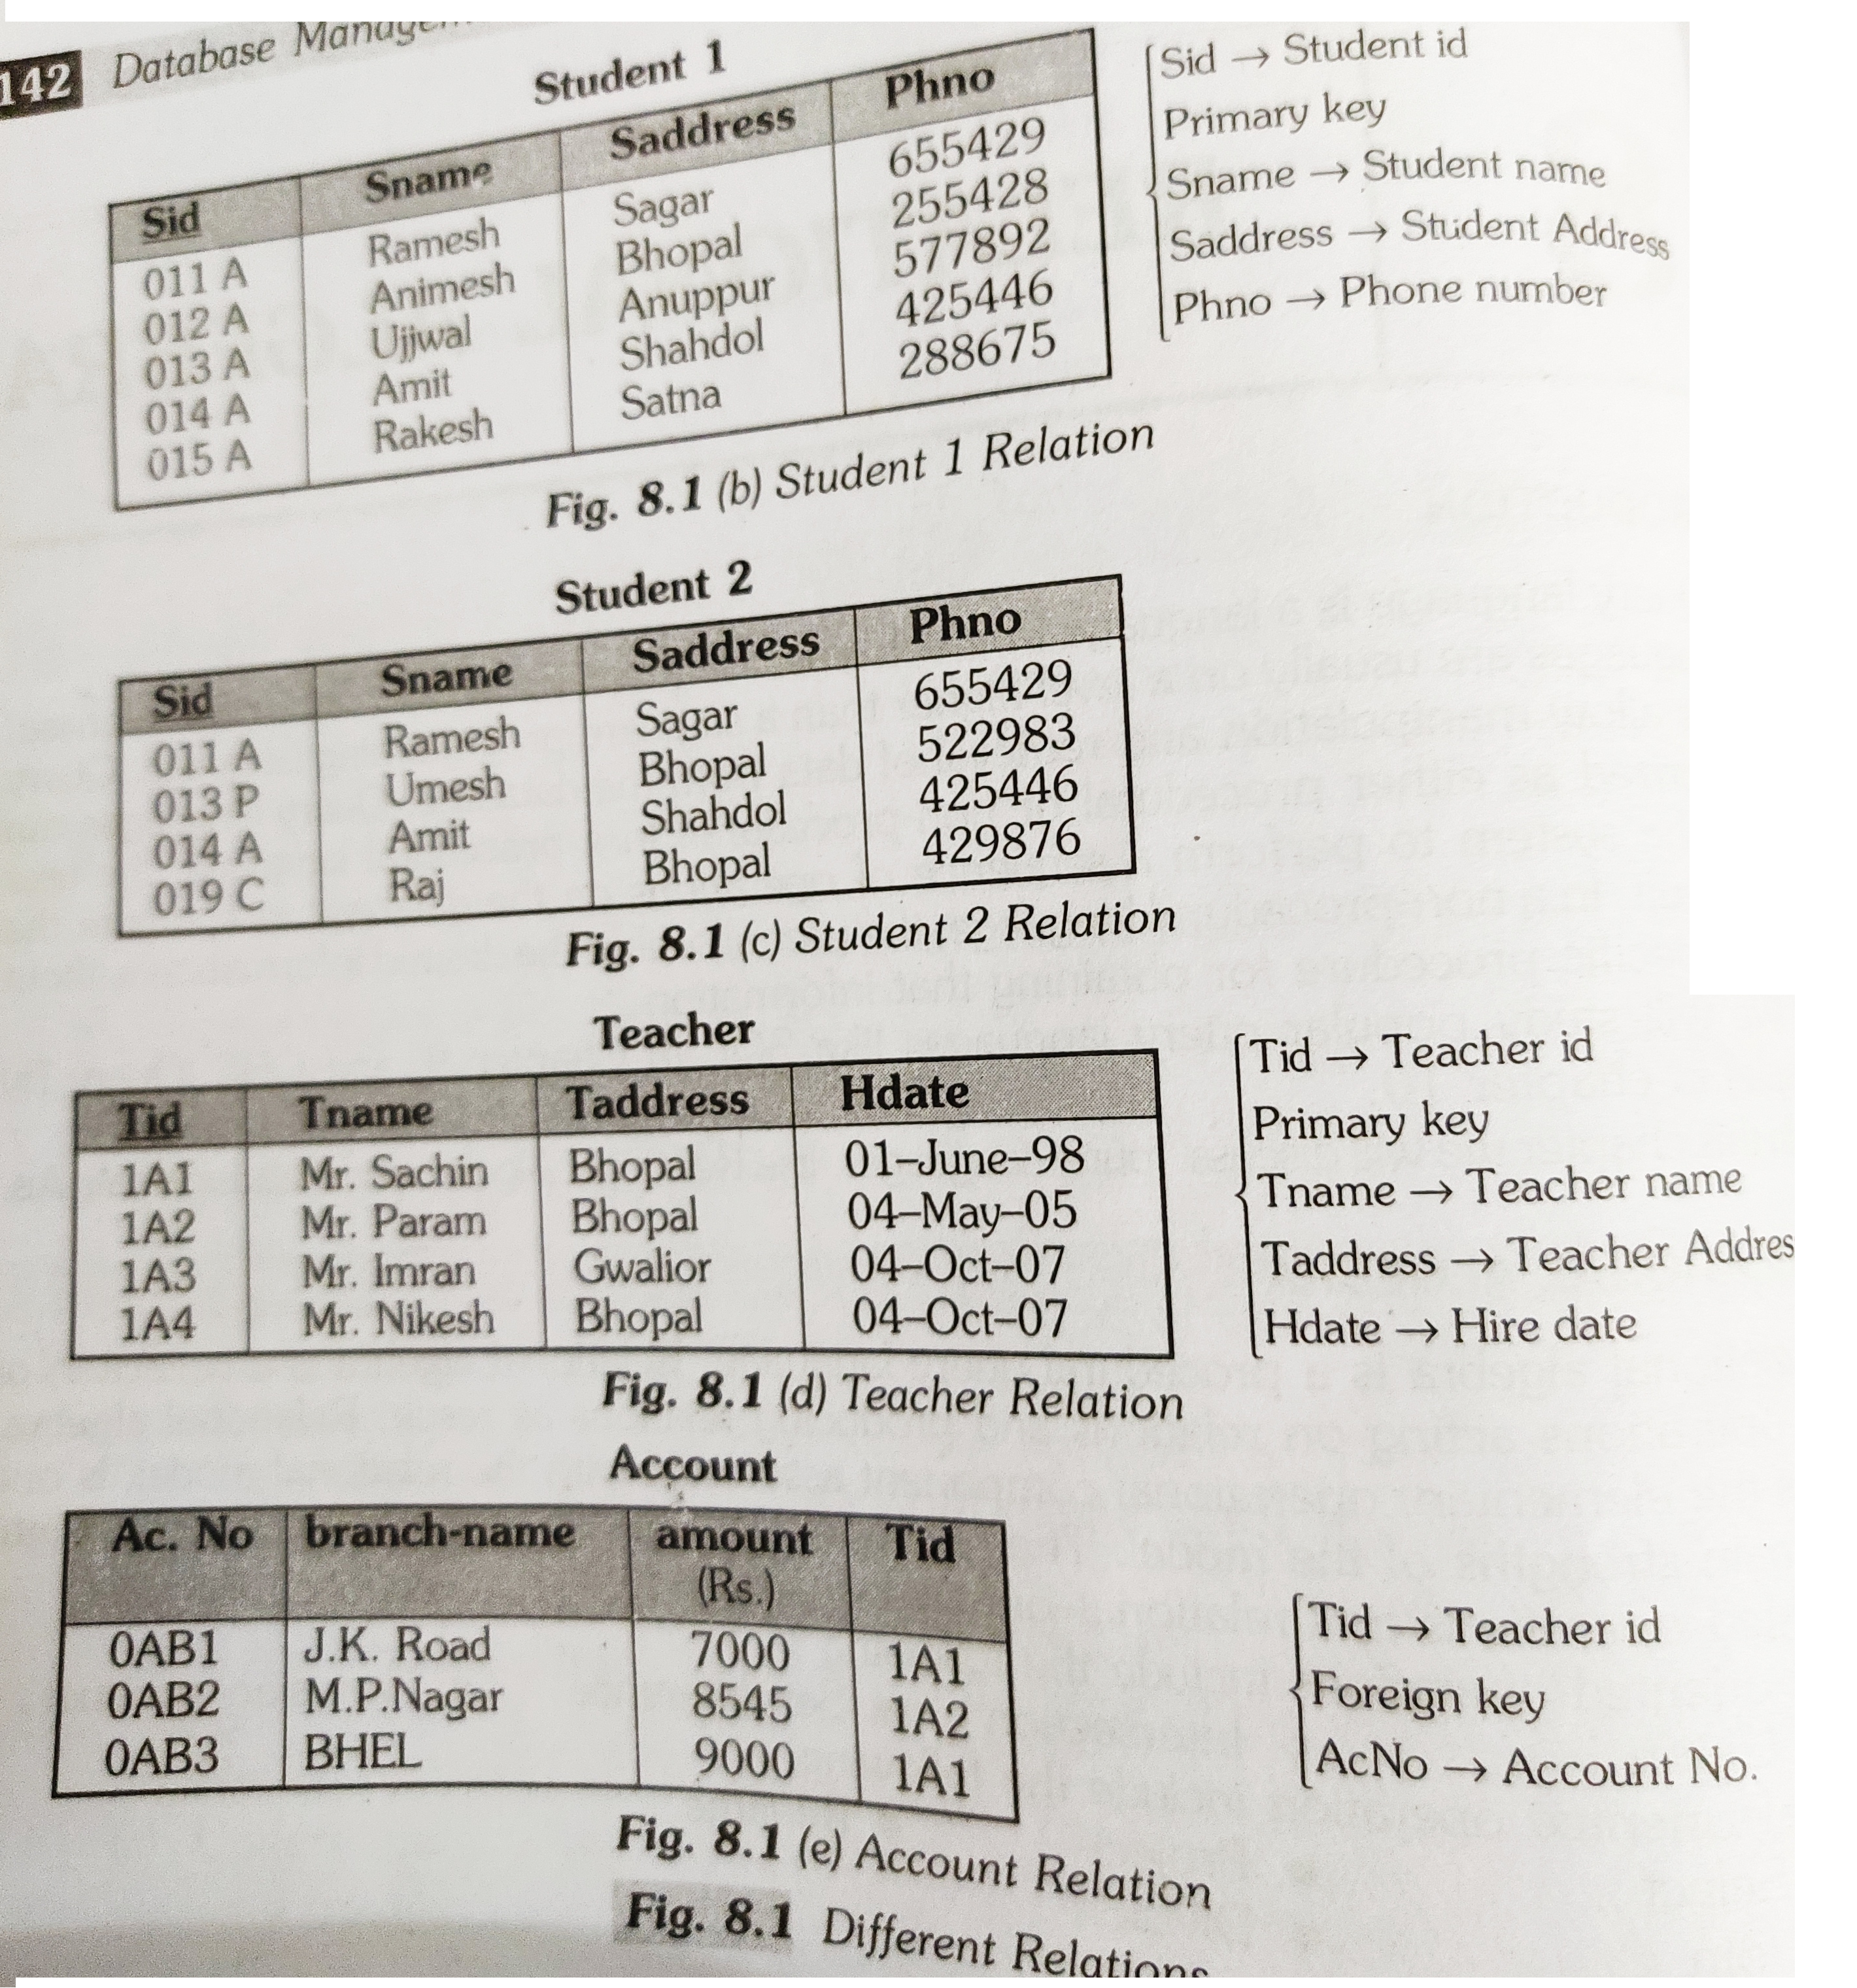
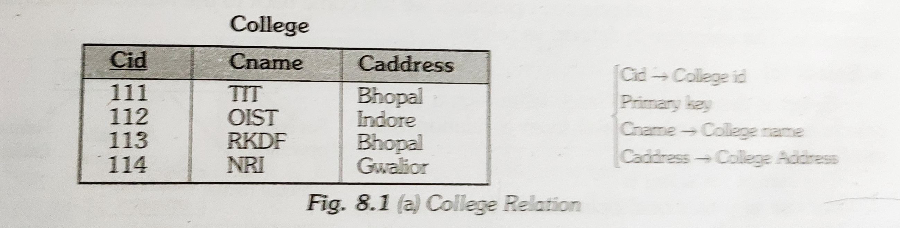
Union

Slide 4
Union
Union (U)
It is represented by symbol U. The union operator builds a relation from tuples appearing in either or both of the specified relation.
The union operation take the set of rows in each relation and combines them eliminating duplicates.

Slide 5
Union
Two relation are union compatible if the following conditions are satisfied:
In general we must ensure that unions are taken between compatible relations.
The number of attributes should be same in the two relations.
Each attribute/column of the first relation must be of same data type as the corresponding column of the second relation. If the data type are not same it must be a convertible data type. That is the first relation data type is convertible to the same data type as the corresponding attribute of second.

Slide 6
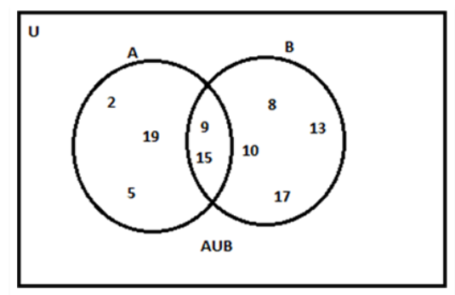
Union
Syntax of Union Operator (∪)
table_name1 ∪ table_name2
A={2,5,9,15,19} and B = {8, 9, 10, 13, 15, 17}. Find A ∪ B
The union of two sets X and Y is equal to the set of elements which are present in set X, in set Y, or in both the sets X and Y. This operation can be represented as;
X ∪ Y = {a: a ∈ X or a ∈ Y}
Let us consider an example, say; set A = {1, 3, 5} and set B = {1, 2, 4} then;
A ∪ B = {1, 2, 3, 4, 5}

Slide 7
Union

Slide 8


